Slide 1


Global Trends in the Chemical Industry
53rd. Council of the Russian Chemists Union
Board of Directors of Association Tsentrlak
Yaroslavl, 23 November 2011
Fabrice Tabankia
CEFIC

Slide 2
Global Chemical Industry

Slide 3
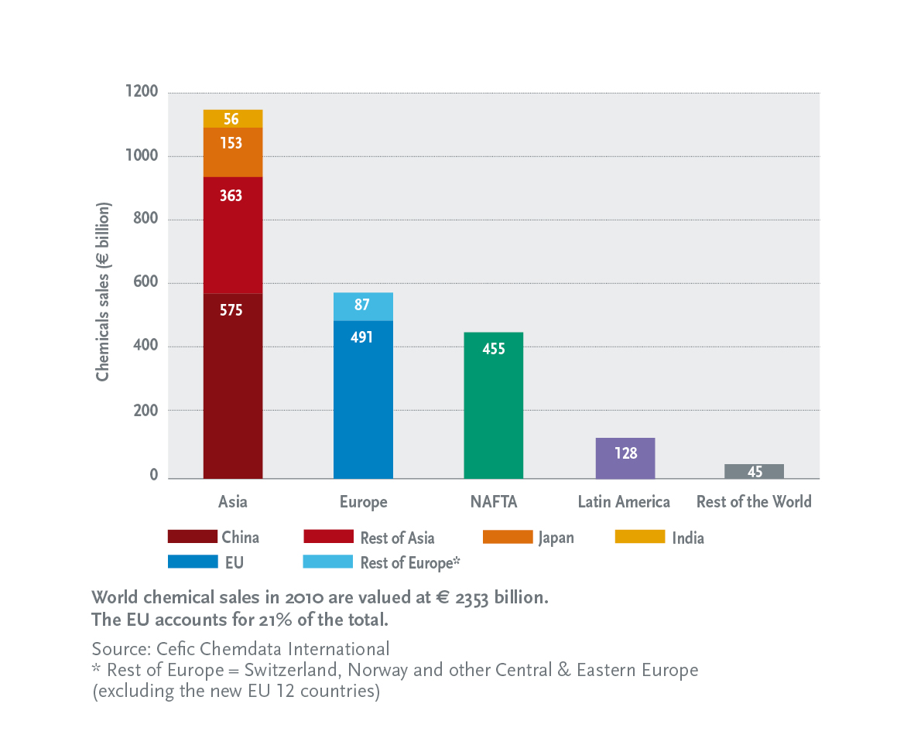
Global Chemicals Sales in 2010
2353 Billion €

Slide 4
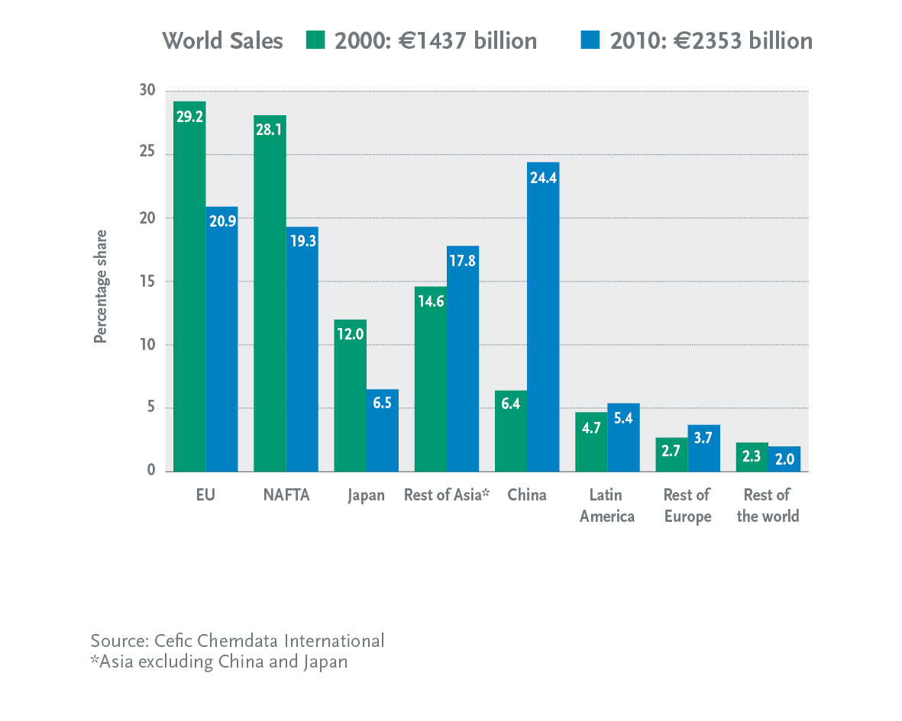
Global Chemicals Market Share

Slide 5
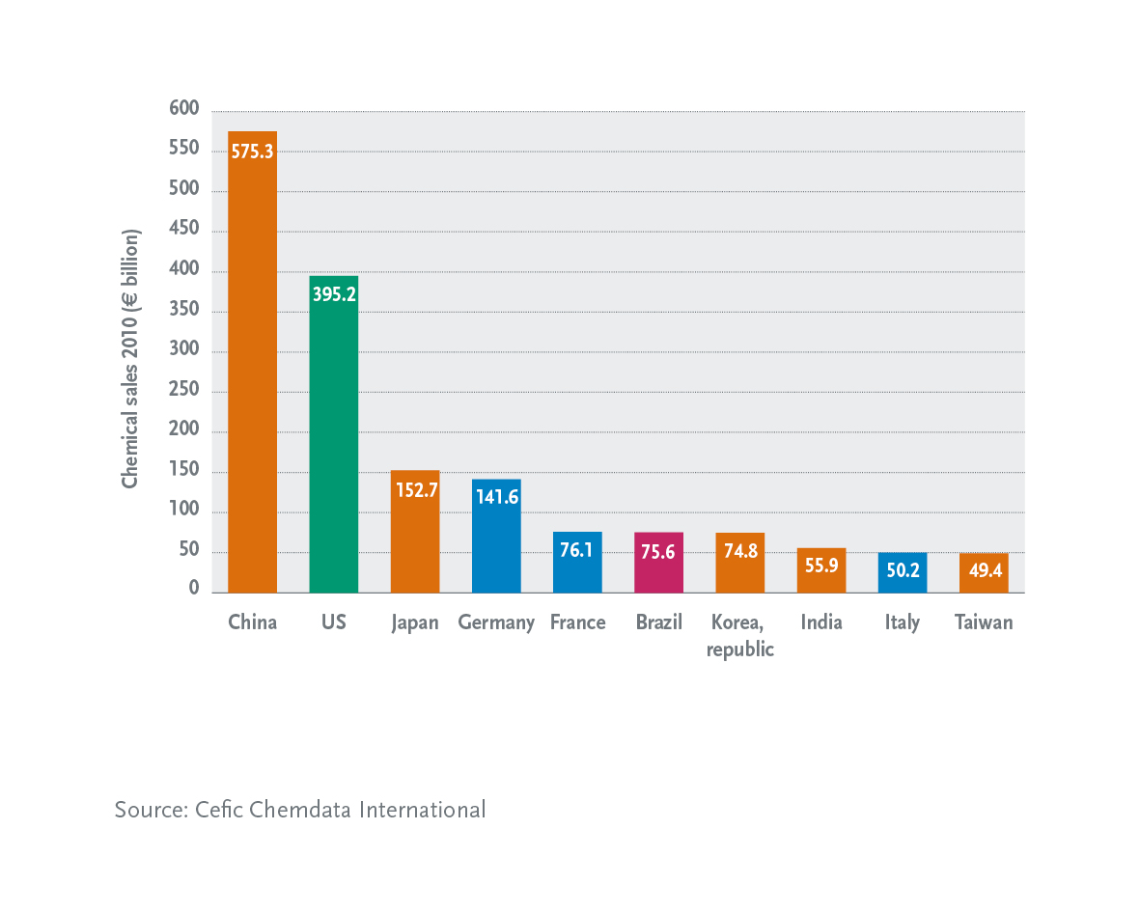
China: World’s Biggest Chemicals Producer in 2010

Slide 6
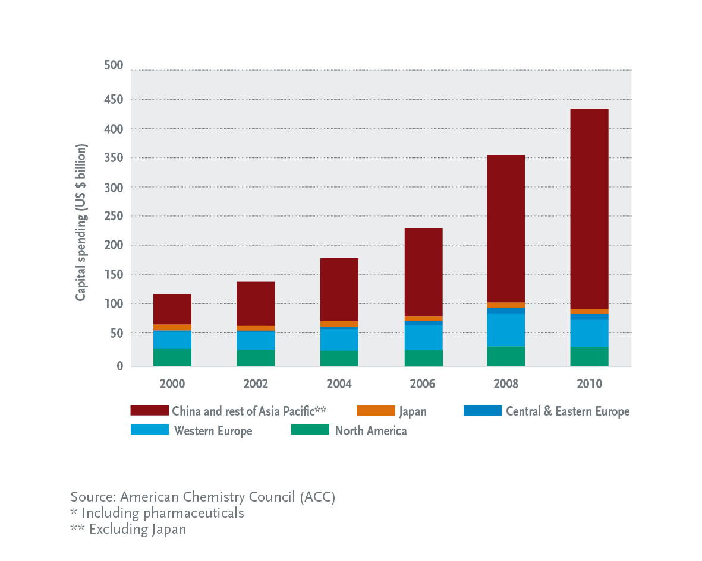
China & AP leading the world’s chemicals investment

Slide 7
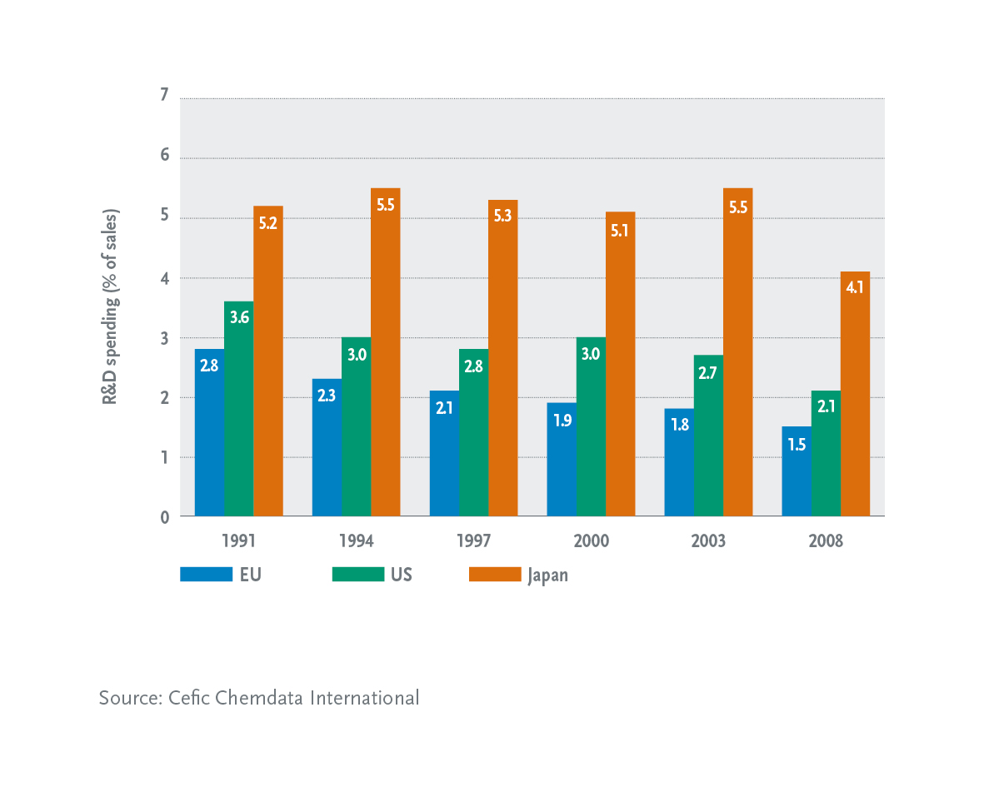
R & D Spending 1991-2008

Slide 8
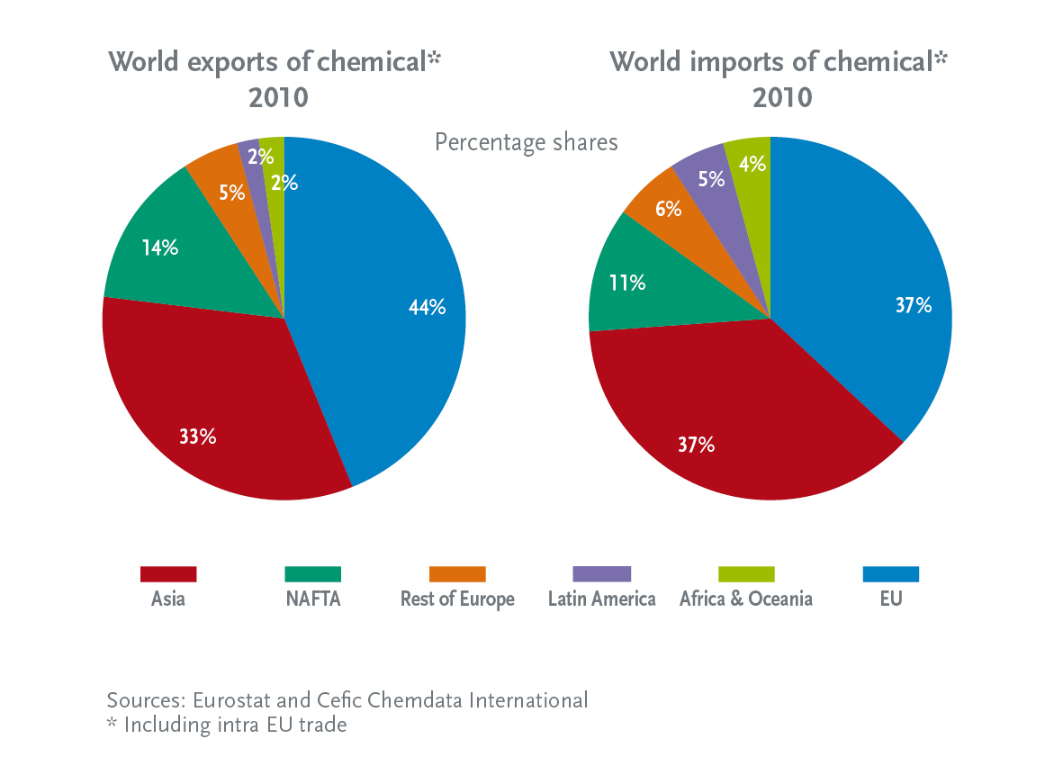
EU: World’s Top Exporter & Importer of Chemicals

Slide 9
EU Chemical Industry

Slide 10
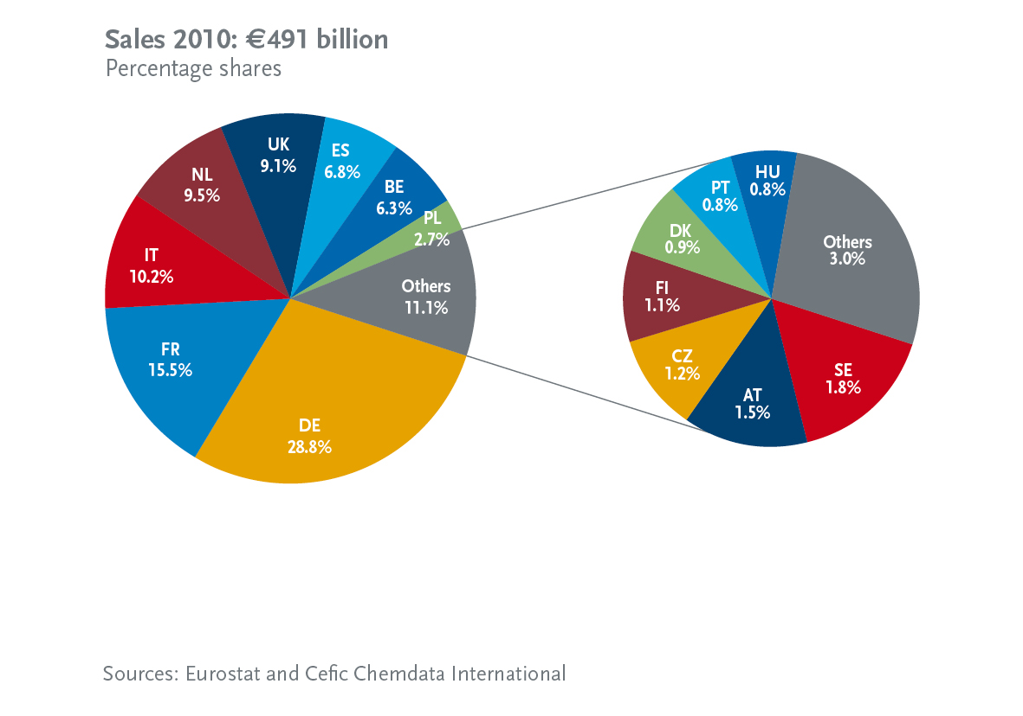
EU: 8 countries account for 90% of chemicals production

Slide 11
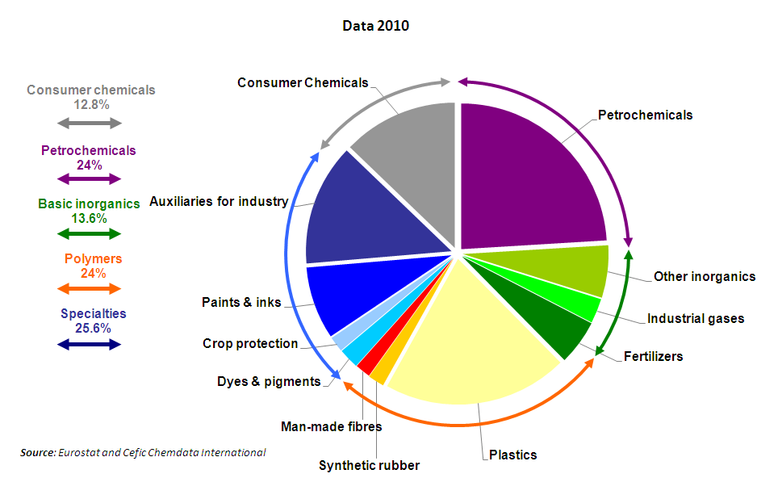
EU Chemicals Industry Structure

Slide 12
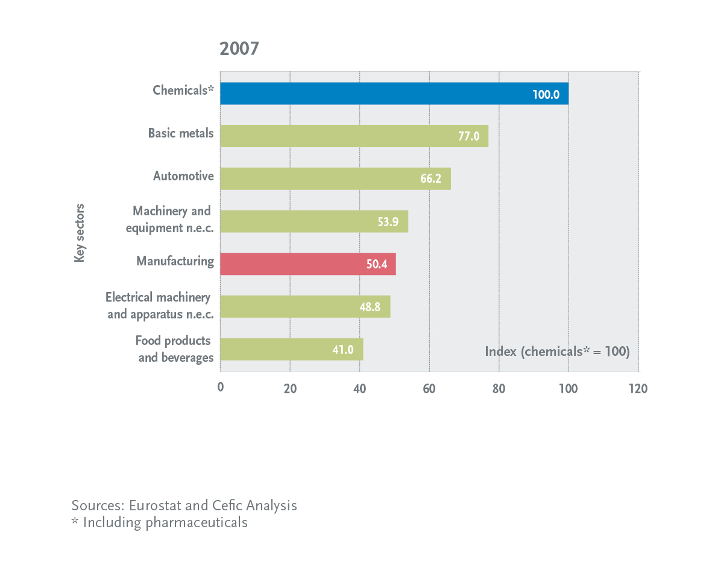
Chemical industry-the leading EU manufacturing sector in terms of value-added per employee
EU Chemicals Industry:
Highest Added-Value per Employee

Slide 13

Trade Balance: € 47 billion in 2010
EU chemicals trade flows in € billion: 2010
NAFTA
Rest of
Europe
24.4
23.8
37.4
35.0
Asia*
EU27
20.3
LAC**
4.0
9.4
28.3
Africa
6.1
Japan
3.1
6.7
9.5
10
China
2.7
Rest of
World
8.7
6.4
* excludes Japan & China **Latin America and the Caribbean
Source: Cefic Chemdata International

Slide 14
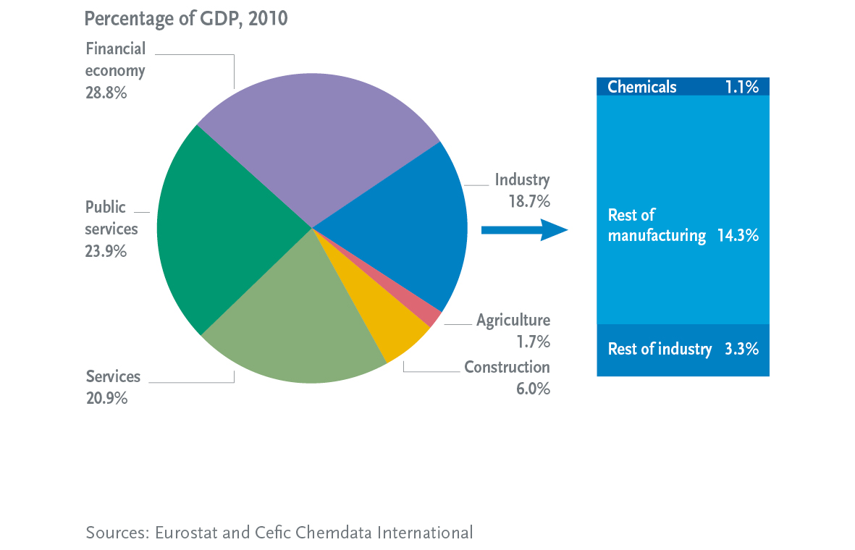
EU Chemicals Industry: 1.1% of total EU’s GDP

Slide 15
CEFIC
Council of the European Chemical Industry

Slide 16
This is Cefic
Since its creation in 1972, Cefic has grown to become one of the
largest industry trade organizations in Europe and in the world
Representing 29.000 chemical companies in Europe
28 National Chemical Federations across Europe
Over 600 direct Company Members from Europe
More than 30 Associate Company Members from around the world
40 Partner Companies & Associations
23 European Affiliated Associations
Operates 101 Sector Groups focusing on 120+ product families and over 60 Strategy
implementation and Issue Teams dealing with the industry’s horizontal issues (REACH,
International Trade, Energy & Climate change, Research & Innovation, …)
About 5000 industry experts from companies and federations participate in the Cefic groups
Close cooperation with the other regions in the world through ICCA

Slide 17
Cefic Priorities 2011
Competitiveness
Sustainable development
Chemicals safety
REACH | 2012 review Registration Nanomaterials |  | X | X
Energy and Climate Change | ETS Minus 20% by 2020 Energy Strategy, roadmaps 2050 | X | X
Innovation | Innovation partnerships HLG key enabling technologies | X | X
Communication | - International Year of Chemistry | X | X | X
Smarter Regulation | - Consistency and workability |  | X | X
Industrial Policy | - HLG recommendations implementation |  | X
Sustainable Development | - Develop strategy | X | X | X
Organisational
- Exploit synergies with Affiliates,
National Federations
HR policy review

Slide 18
Conclusion
A Sustainable and Competitive EU Chemical Industry requires:
More innovation and research:
Strengthen innovation networks, increase quality and effectiveness of R&D
Smart regulation takes the competitiveness of industry into account
Level playing field for sourcing energy and feedstock
Open markets with fair competition

Slide 19
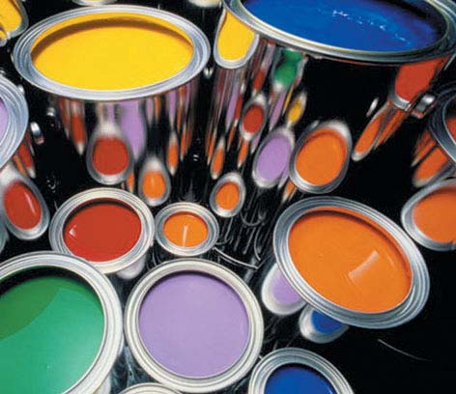
CEPE
The European Council of
Paint and Printing Ink producers

Slide 20
CEPE represents in the EU 27
Approx. 900 paint manufacturers
75 pr. ink manufacturers
20 artists’ colours manufacturers
Directly employed: 110.000 employees
Member Companies; multinationals and SMEs
This represents approx. 80 % of market

Slide 21
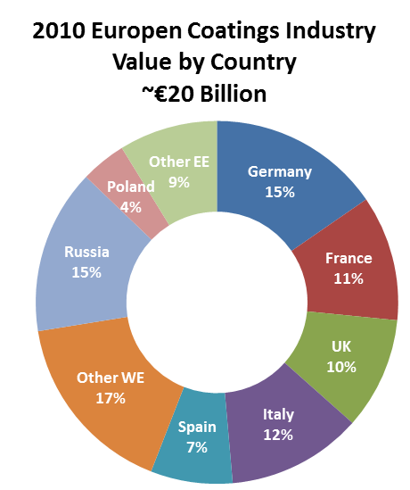


Demand by European Country
Central & Eastern Europe now make up over one-fourth of the European market.

Slide 22
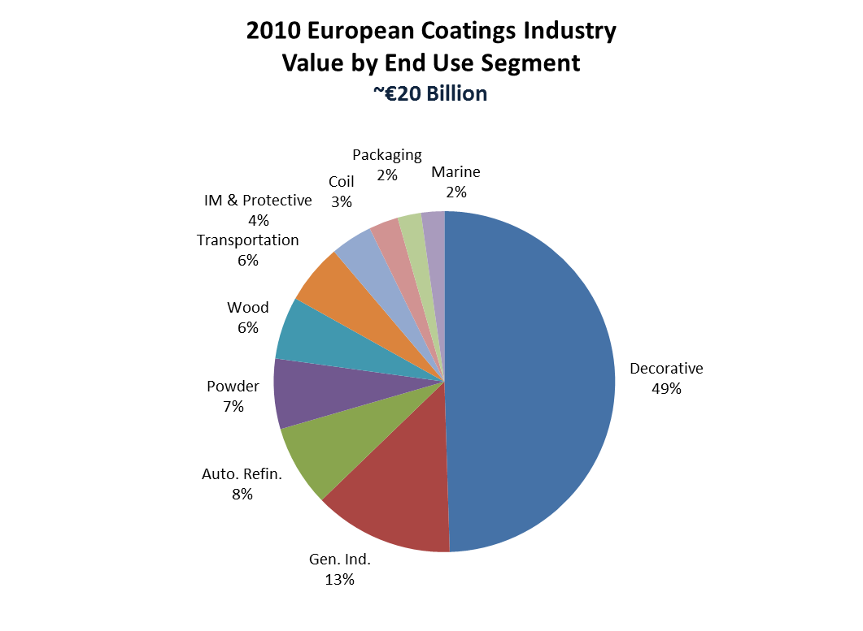

End-Use Segments
Decorative coatings comprise the largest single component of the market.
Only General Industrial, at 13%, accounts for over 10% of the total market.

Slide 23
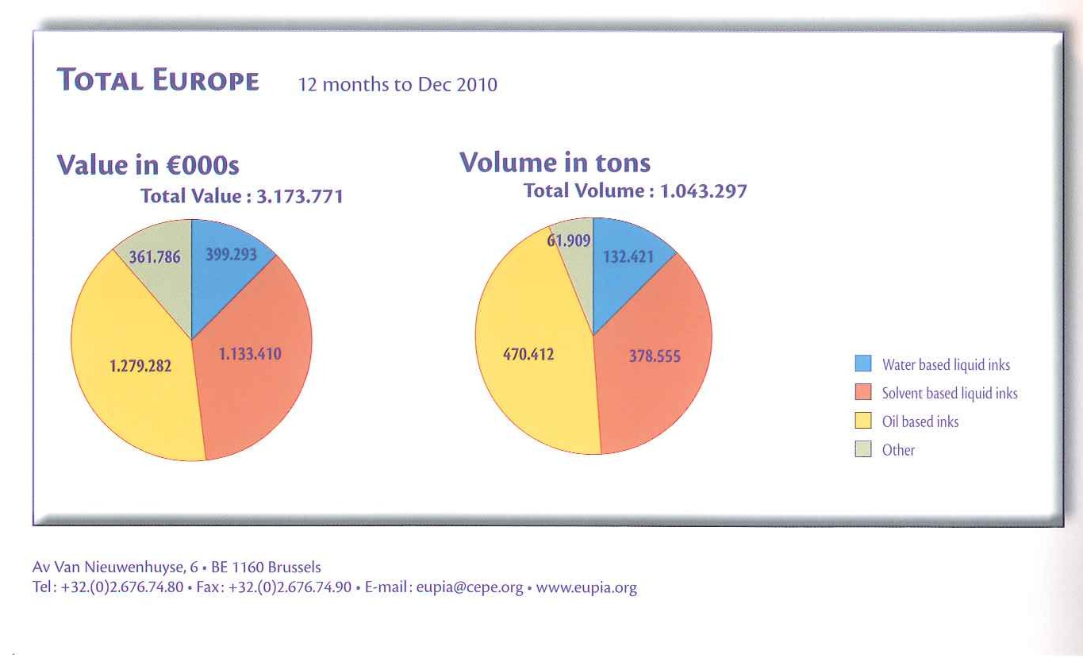
The Printing Ink Market
11%
13%
6%
13%
40%
36%
45%
36%

Slide 24
The main EU legislative issues that impact paints and inks from formulating up till waste.
Formulating
VOCs
Biocides
R
E
A
C
H
Labelling
CLP
Transport
Applying product
Food
Pack
In use of cured (dried) product
Biocides
Indoor
Air
After use + waste

Slide 25
Thank You !
Please visit www.cefic.org for more information

